Slide 1
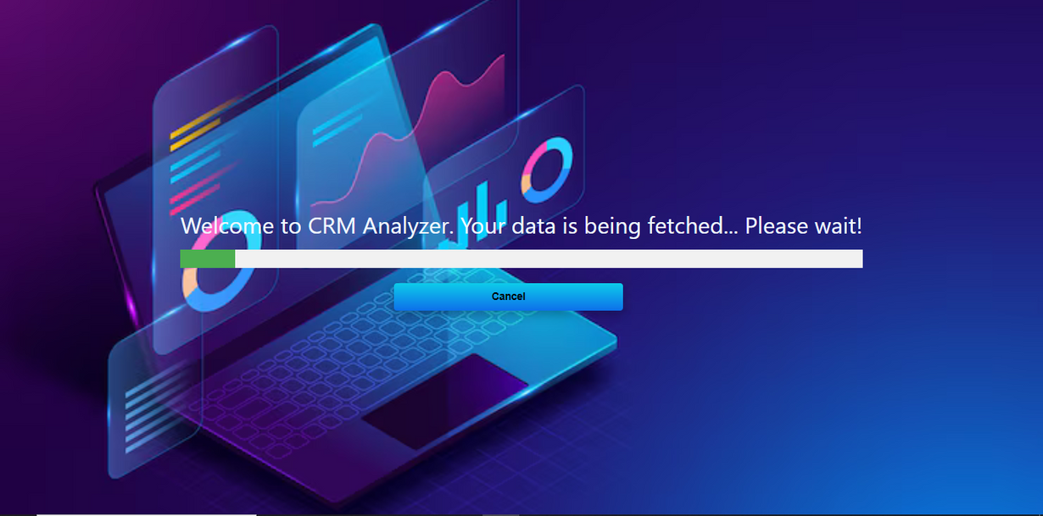


CRM COMPLEXITY ANALYZER
Provides the Insight of CRM Components

Slide 2

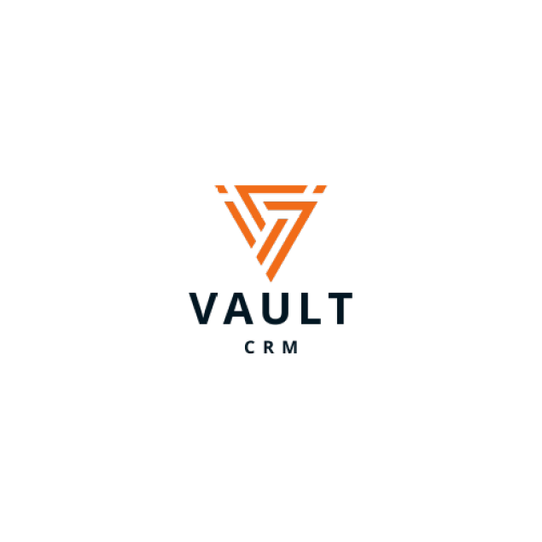


CRM Complexity Analyzer
The Complexity Analyzer Tool is a comprehensive solution designed to meticulously analyze the Meta Data of Veeva/Salesforce CRM systems. It not only evaluates the volume of each component within the CRM but also meticulously assesses the integrations between the CRM and various other applications. By delving into the intricate details of the CRM architecture, this tool effectively find complexity issues, offering tailored insights and solutions to optimize CRM performance.

Slide 3
Setup and Configuration
Creating a Connected App in Salesforce
Login to Salesforce: Use your Salesforce administrator credentials to log in to your Salesforce org.
Navigate to Setup: Click on the gear icon in the upper-right corner and select "Setup.“
Create Connected App:
In the Quick Find box, enter "App Manager" and select "App Manager."
Click "New Connected App."
Fill in the required fields:
Connected App Name: Choose a name for your app.
API Name: This will be auto-filled based on the Connected App Name.
Contact Email: Enter your email address.
Enable OAuth Settings: Check this box.
Callback URL: Enter a valid URL (e.g., https://login.salesforce.com/services/oauth2/callback).
Selected OAuth Scopes: Add necessary scopes (e.g., Full Access (full)).
Save the connected app. You will be provided with the Client ID and Client Secret.
Security Token: This can be obtained by resetting your security token from your Salesforce user settings.

Slide 4
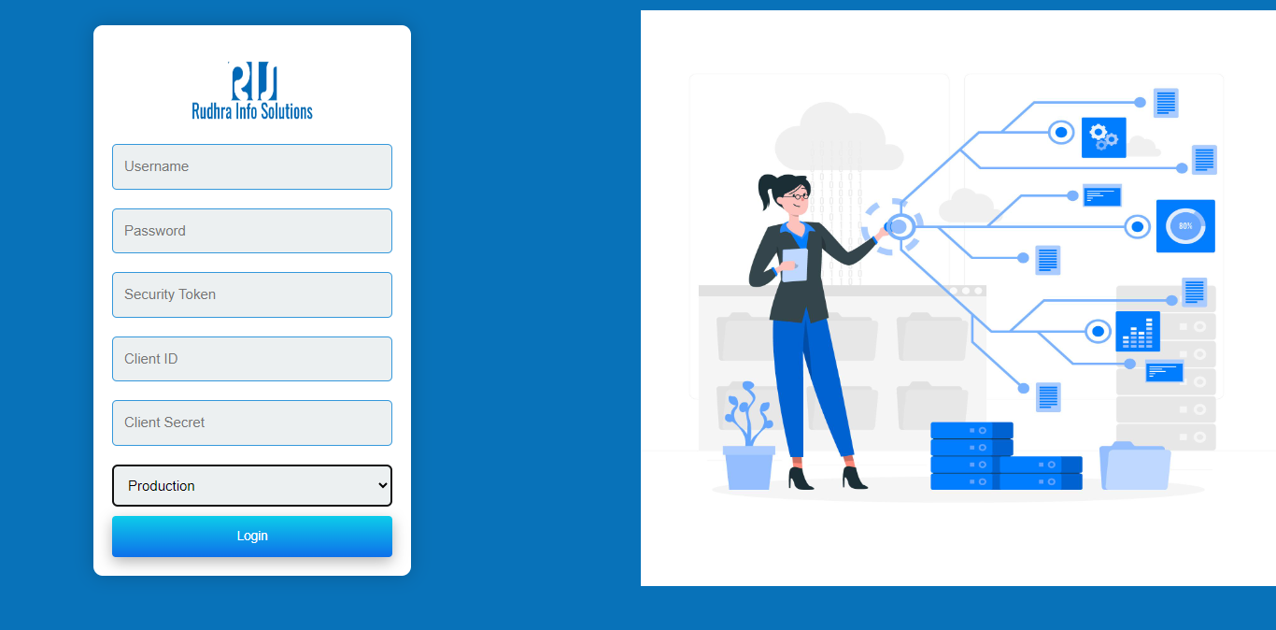



Login Credentials
User Name
Password
Security Token
Client ID
Client Secret
Production or Sandbox
Security measures for User Data Protection, Integration & Analysis.

Slide 5

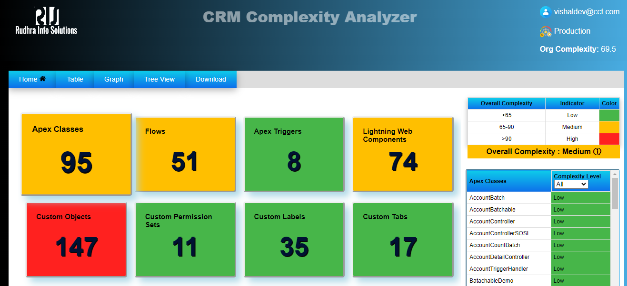





Overview of Our CRM complexity analyzer
Volume of object in each components of Integrated CRM.
Overview of Analysis
Risk Level of CRM Indicator
Low
Medium
High

Slide 6
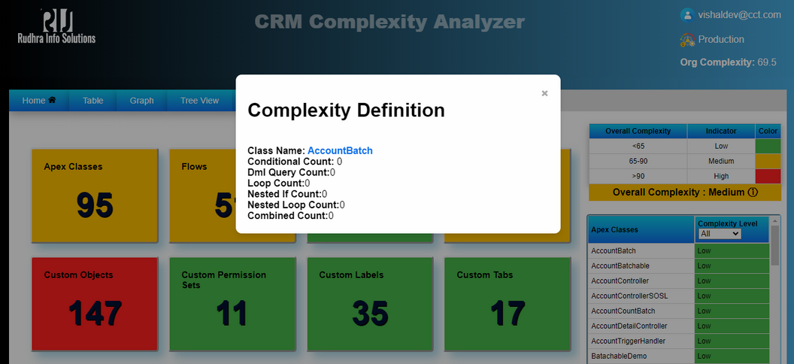
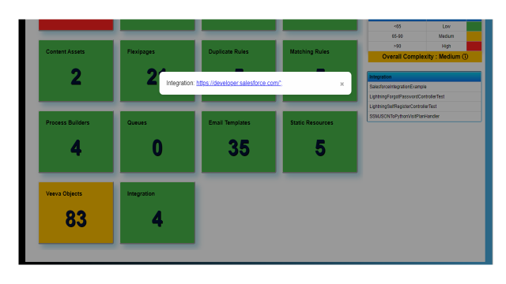
Complexity Rating
The Complexity Analyzer tool provides detailed insights into each Apex class and Trigger in Veeva/Salesforce CRM. It analyzes factors like conditional counts, DML query usage, and loop counts, enabling users to optimize performance and efficiency quickly.
Integrations Count
Complexity analyzer allows users to get the count of integrations & end-point URL of connected application

Slide 7
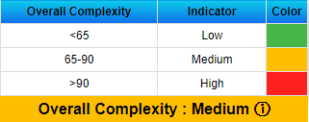
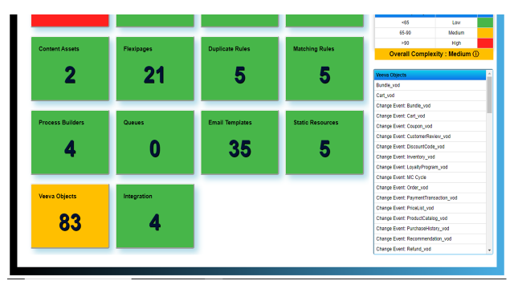
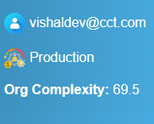
Complexity Analyzing Indicators
Final Indicator, shows complexity as Low, Medium, and High, and its impact on CRM org.
Explain the significance of each metric of Apex Classes, Flows, Custom Objects, Custom Permission Sets, Custom Labels and contribute to the overall complexity score.

Slide 8
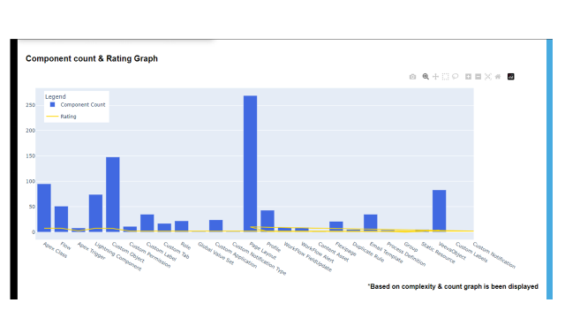

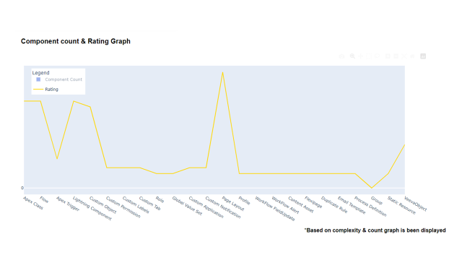
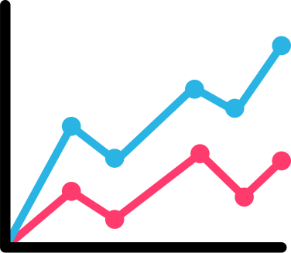
Dashboard of Component Count & Rating of Risk Analysis
Count of Component
Bar Chart
Complexity Rating of Component
Line Chart

Slide 9
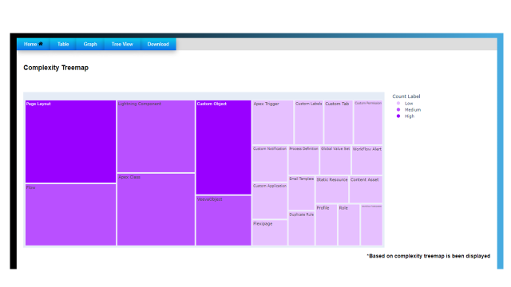
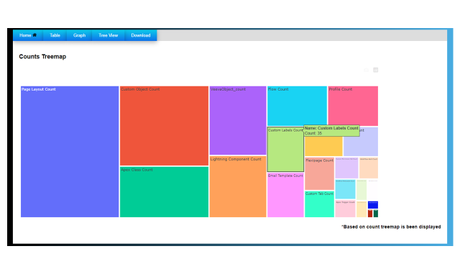
Tree map view Dashboard
Easy to view Complexity of Components based on rating
High
Medium
Low
Illustrating the component counts and providing users with a visual representation.

Slide 10
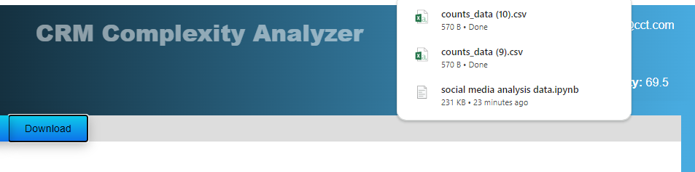

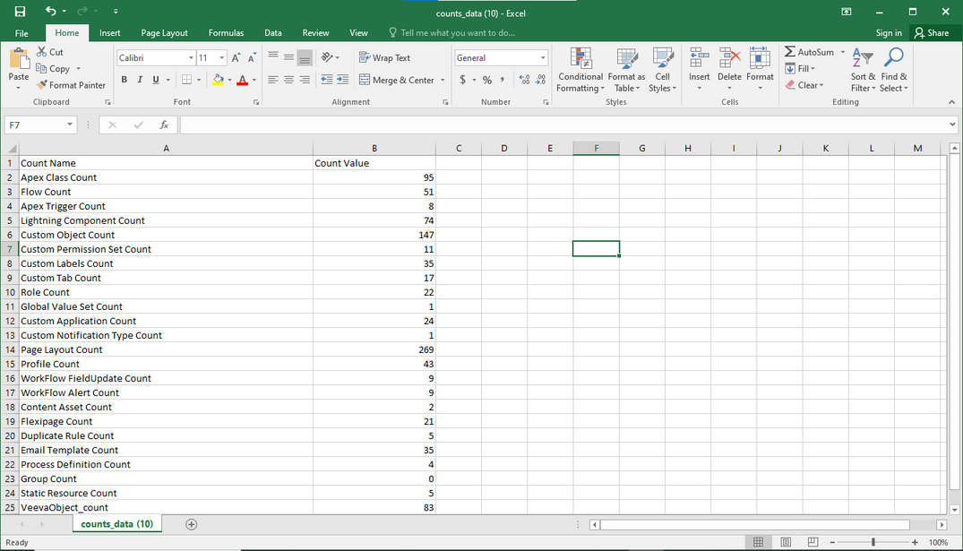

Download Feature of CSV File

Slide 11




Thank You
www.rudhrainfosolutions.com

